Slide 1


Unsupervised and Semisupervised Machine Learning Frameworks for Multiclass Tool Wear Recognition
Presented By:
P. Shiva Charan (22D41A7296)
N. Harini (22D41A7285)
P. Sanjana (22D41A7291)
Y. Sunil Reddy (22D41A72C7)
Guide :
R. Madhava Reddy
(Assistant Professor)
06
Batch No :

Slide 2

TABLE CONTENTS
Abstract
Introduction
Existing System
Disadvantages
Proposed System
Advantages
System Requirements
Modules
System Architecture
UML Diagrams
Conclusion

Slide 3
ABSTRACT
Tool Condition Monitoring (TCM) is essential for maintaining product quality and reducing machine downtime in manufacturing. Traditional TCM systems depend on supervised learning models that require large amounts of labeled data, which are costly and difficult to obtain. This project introduces unsupervised and semi-supervised machine learning frameworks for multiclass tool wear recognition, capable of working effectively with limited or unlabeled data. Using advanced methods like SAE, SSAE, SOM, SVM, and Random Forest, and combining data from microphone and accelerometer sensors, the system accurately detects multiple stages of tool wear.

Slide 4
INTRODUCTION
In modern manufacturing, monitoring cutting tool conditions is vital for maintaining product quality and minimizing downtime. Traditional Tool Condition Monitoring (TCM) systems depend on supervised learning methods that require large labeled datasets, which are costly and time-consuming to produce. This project develops unsupervised and semi-supervised machine learning frameworks to recognize multiple stages of tool wear using minimal or no labeled data. By combining microphone and accelerometer sensor data with advanced algorithms like SAE, SSAE, SOM, and SVM, the system enables accurate and efficient tool wear prediction.

Slide 5
EXISTING SYSTEM
Relies mainly on supervised learning models that need large amounts of labeled data.
Data labeling in real manufacturing environments is costly and time-consuming.
Existing unsupervised methods are limited to binary classification (e.g., “worn” or “not worn”).
Fails to capture the progressive stages of tool wear accurately.
Lacks adaptability to real-world scenarios with scarce labeled data.
Provides limited predictive capability for proactive maintenance and decision-making.

Slide 6
DISADVANTAGES
Requires large labeled datasets, making it unsuitable for real-time industrial environments.
Manual data labeling is costly, time-consuming, and prone to human error.
Existing models are limited to binary classification, ignoring intermediate tool wear stages.
Poor scalability when dealing with diverse machines and sensor conditions.

Slide 7
PROPOSED SYSTEM
Introduces unsupervised and semi-supervised learning frameworks for tool wear recognition.
Utilizes advanced models like SAE, SSAE, Laplacian Score, SOM, SVM, and Random Forest for accurate classification.
Enables multiclass tool wear recognition instead of simple binary classification.
Integrates data from multiple sensors (microphone and accelerometer) for better accuracy.

Slide 8
ADVANTAGES
Reduces labeling cost by efficiently using unlabeled or partially labeled data.
Recognizes multiple stages of tool wear for detailed and accurate monitoring.
Improves predictive maintenance, preventing unexpected machine failures.
Enhances accuracy and robustness through sensor fusion and feature learning.
Adapts well to real-world environments with limited labeled data.
Scalable and cost-effective, suitable for modern smart manufacturing systems.

Slide 9
SYSTEM REQUIREMENTS
Hardware Requirements:
Sensors: Accelerometers, force sensors, or acoustic emission sensors.
Data Acquisition System: Hardware to read and digitize sensor data.
Server: A computer to run the analysis, with a powerful CPU and sufficient RAM.
Software Requirements:
Operating System: Linux
Programming Language:Python
Libraries and Frameworks: Pandas and NumPy, SciPy, Scikit-learn, TensorFlow, or PyTorch.

Slide 10
MODULES
Data Logger Module: Collects and stores real-time sensor data from different machines.
Signal Processing Module: Extracts important features from raw sensor signals such as vibration and acoustic data.
ML Framework Module: Implements unsupervised (e.g., K-Means, DBSCAN) and semi-supervised (e.g., label propagation) algorithms for tool wear classification.
Predictive Maintenance Module: Generates tool wear status and sends alerts for timely maintenance actions.
Visualization Module: Displays tool wear progression, accuracy metrics, and maintenance insights through graphical dashboards.

Slide 11
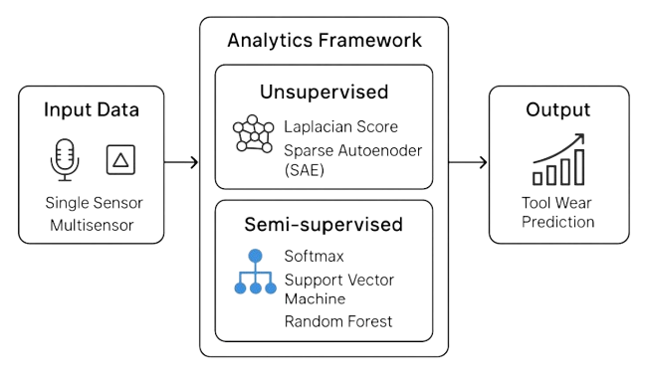
SYSTEM ARCHITECTURE

Slide 12
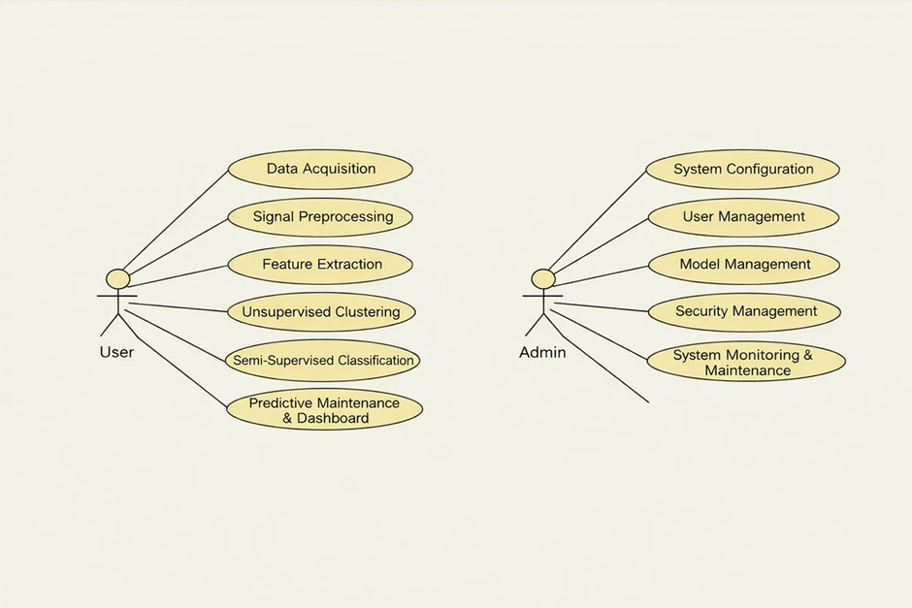
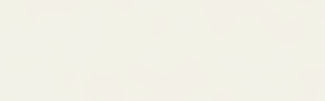
UML DIAGRAMS
1. Use Case Diagram
A diagram that shows how users (actors) interact with a system and its functionalities.

Slide 13
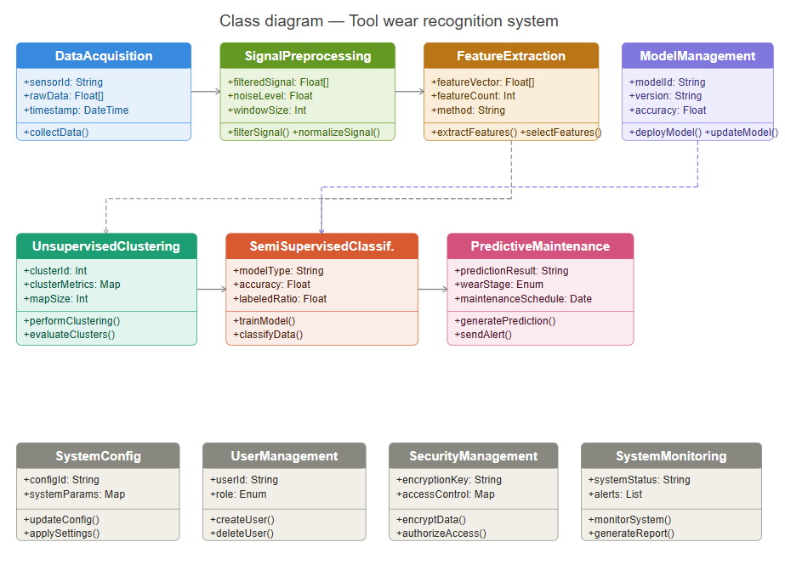
UML DIAGRAMS
2. Class Diagram
A diagram that represents the structure of a system by showing classes, their attributes, methods, and relationships.

Slide 14
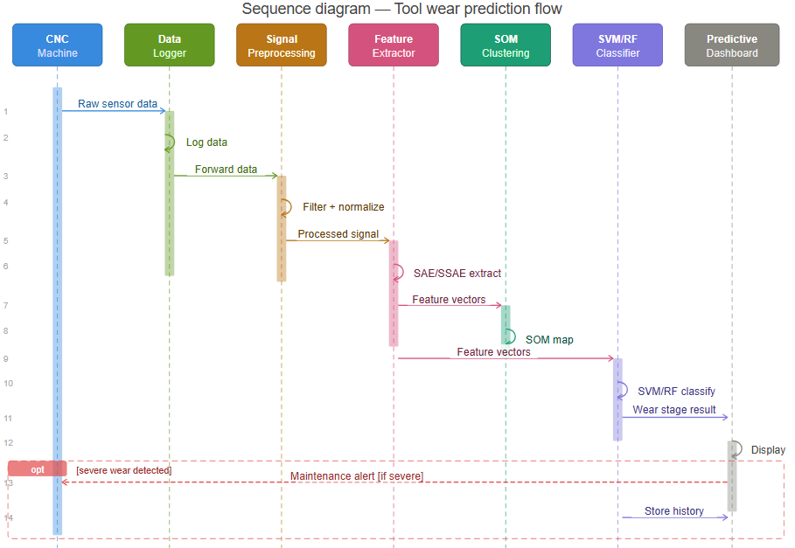
UML DIAGRAMS
3. Sequence Diagram
A diagram that shows the order of interactions between objects over time.

Slide 15
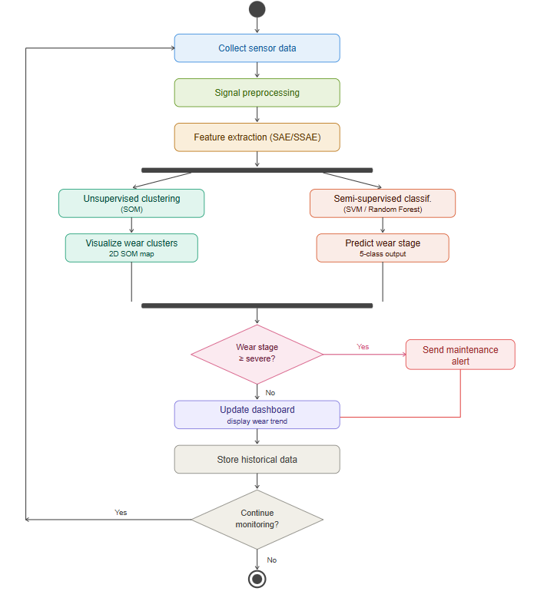
UML DIAGRAMS
4. Activity Diagram
A diagram that represents the flow of activities or steps in a process or workflow.

Slide 16
CONCLUSION
The proposed Unsupervised and Semi-Supervised Machine Learning Frameworks provide an efficient and intelligent solution for multiclass tool wear recognition in manufacturing systems. By reducing dependency on labeled data and integrating data from multiple sensors, the system ensures accurate and reliable tool condition monitoring. The combination of advanced algorithms such as SAE, SSAE, SOM, SVM, and Random Forest enables effective detection of wear progression and supports predictive maintenance strategies. The framework is scalable, cost-effective, and adaptable, making it highly suitable for real-world industrial applications in smart manufacturing.

Slide 17
THANK YOU

